Slide 1
ARDS Update
臺北榮民總醫院 胸腔部呼吸治療科 余文光醫師

Slide 2
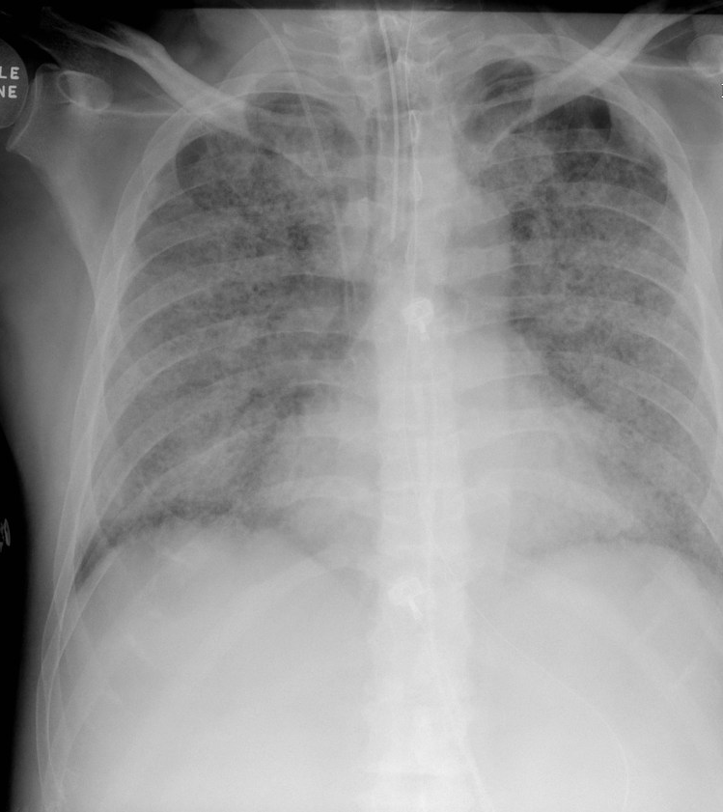
ARDS: Definition
Acute onset noncardiogenic pulmonary edema and hypoxemia requiring mechanical ventilation.

Slide 3
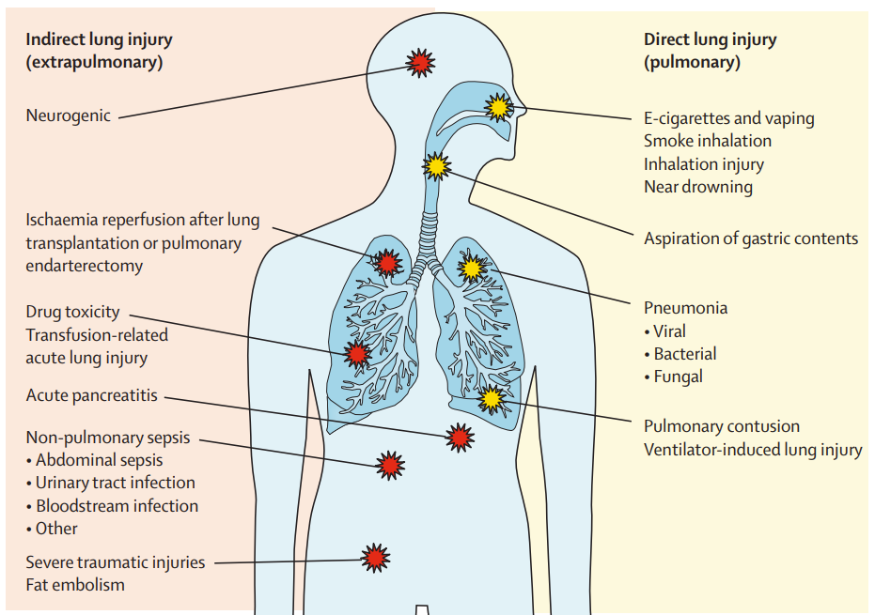
ARDS: Causes
Bellani G JAMA 2016;315:788. Bos Lieuwe & Ware Lorraine Lancet 2022;400:1145

Slide 4
ARDS: Definition
Int J Mol Sci 2018;19:588

Slide 5
ARDS: Definition
Am J Respir Crit Care Med. 2024;209(1):37-47

Slide 6
ARDS: Pathophysiology
Injury to lung’s epithelial and endothelial barriers
Physiological consequences of injury to the alveolar-capillary barrier
Lung and systemic inflammation
Role of mechanical ventilation in propagating lung injury
Resolution, repair, and fibrosis
Bos Lieuwe & Ware Lorraine Lancet 2022;400:1145

Slide 7
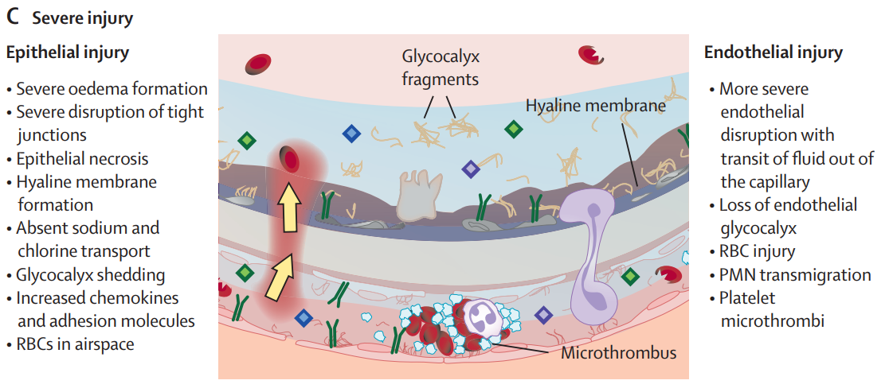
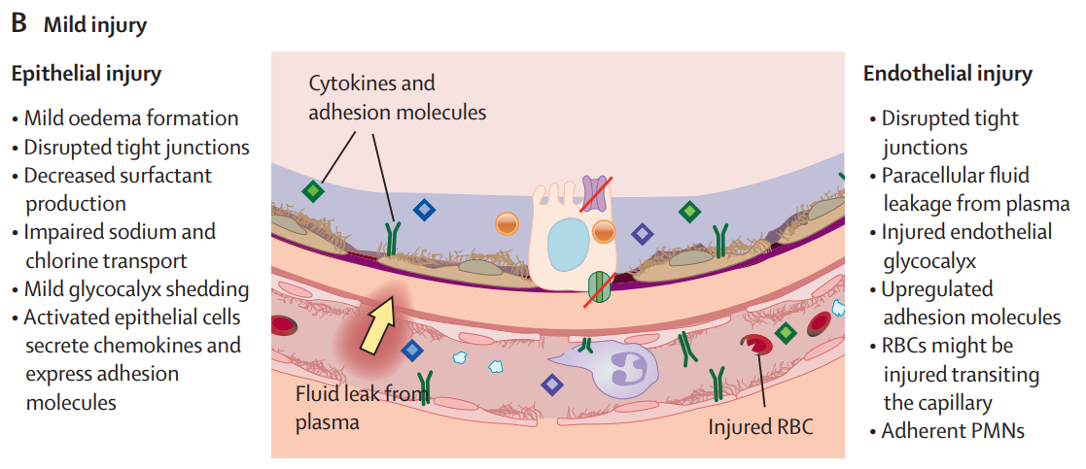
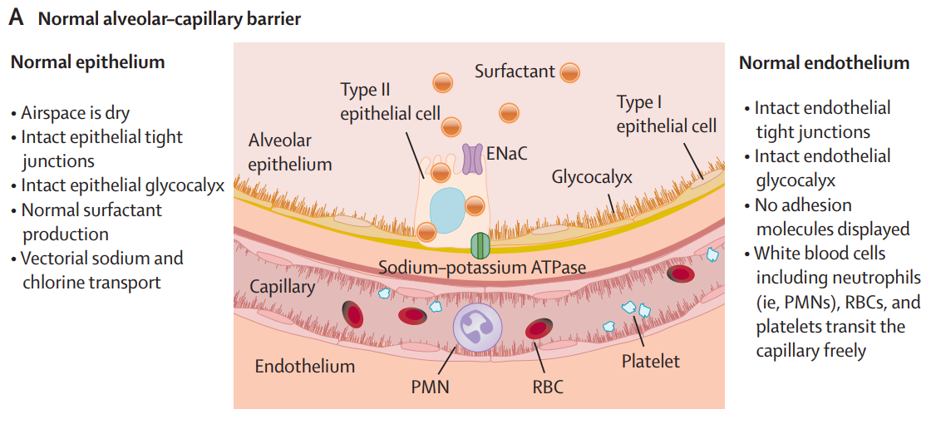
Pathophysiology: Injury to Pulmonary Epithelial and Endothelial Barriers
Bos Lieuwe & Ware Lorraine Lancet 2022;400:1145

Slide 8
Pathophysiology: Consequences of ARDS
 | Physiological manifestation | Clinical findings
Alveolar-capillary barrier injury with interstitial/alveolar edema | Decreased lung compliance | Increased WOB
Diffuse alveolar filling | V/Q mismatch and shunt | Hypoxemia Diffuse bilateral radiographic opacities
Surfactant inactivation and decreased production | End-expiratory alveolar collapse | Favorable response to PEEP
Platelet and endothelial activation with lung microvascular thrombosis, and obstruction or destruction of the lung vascular bed | Increased dead space ventilation Pulmonary arterial hypertension | High minute ventilation, hypercarbia RT heart failure
Leak of lung inflammatory mediators into systemic circulation | Systemic inflammatory response syndrome | Multi-organ dysfunction
WOB = work of breathing. PEEP = positive end-expiratory pressure. Bos Lieuwe & Ware Lorraine Lancet 2022;400:1145

Slide 9
Pathophysiology: Pulmonary and Systemic Inflammation
Neutrophils (early): ROS, proteases, prostaglandins, leukotrienes, Neutrophilic extracellular traps, activating NRLP3 inflammasome, local release of IL-1β, IL-18
Macrophage: the release of proinflammatory cytokines, neutrophil chemoattractant
Pulmonary epithelial cells: the release of neutrophil chemoattractant
Pulmonary endothelial cell: pro-inflammatory cytokines, glycocalyx.
Pulmonary and non-pulmonary organ dysfunction: kidney, brain with poor short-term and long-term outcomes
Mart MF Expert Rev Respir Med 2020;14:577. Bos Lieuwe & Ware Lorraine Lancet 2022;400:1145

Slide 10
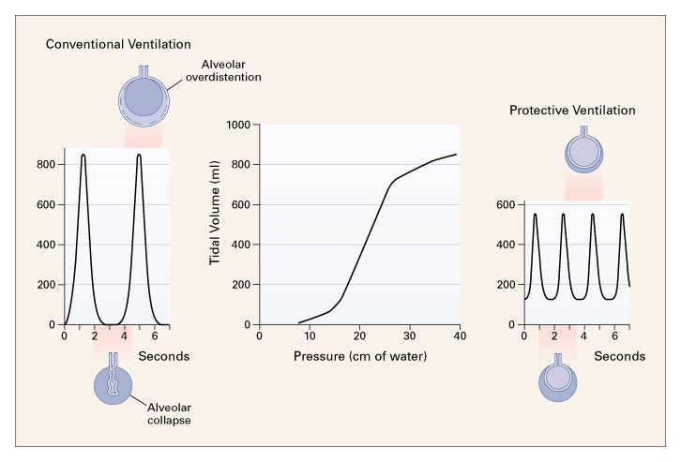
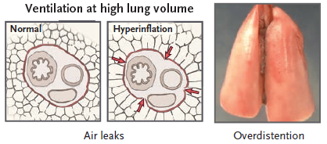
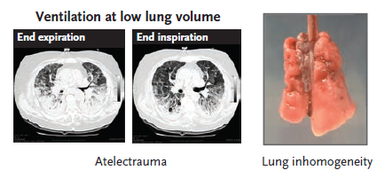
Pathophysiology: Ventilator-Induced Lung Injury
Driving Pressure
Positive End Expiratory Pressure (PEEP)
Arthur Slutsky et al N Engl J Med 2013;369:2126-2136

Slide 11
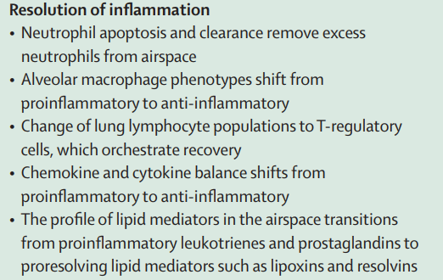
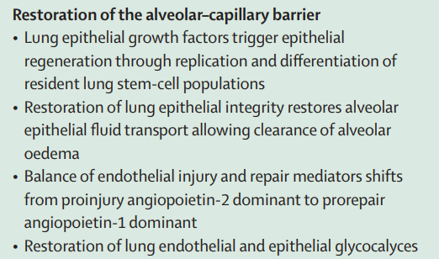
Pathophysiology: Resolution, Repair, and Fibrosis
Bos Lieuwe & Ware Lorraine Lancet 2022;400:1145

Slide 12
ARDS Heterogeneity
Duggal A Minerva Anestesiol 2015;81:567. Bos Lieuwe & Ware Lorraine Lancet 2022;400:1145

Slide 13
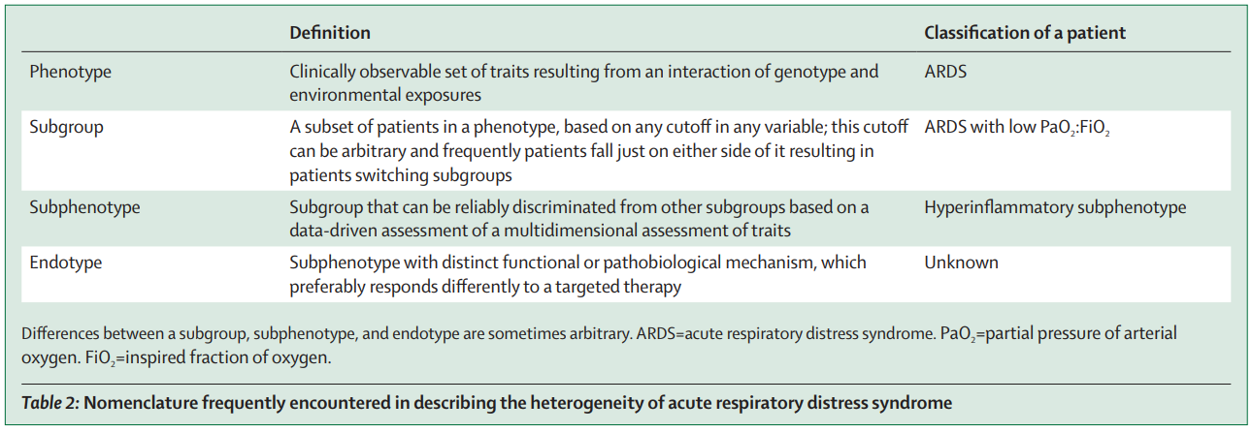
Phenotyping ARDS: Definition
Bos Lieuwe & Ware Lorraine Lancet 2022;400:1145

Slide 14
Phenotyping ARDS: Subphenotypes
Subphenotypes by causes:
pulmonary = more alveolar epithelial injury, more alveolar inflammation over localized lung
extra-pulmonary = increased diffuse endothelial injury and systemic inflammation, a better response to lung recruitment strategies
Sub-phenotypes by gender:
Plasma transfusion from female donors as a major risk factor for transfusion-related ALI
Subphenotypes by COVID-19 vs. non-COVID19 ARDS:
Benefit from corticosteroid treatment in the RECOVERY trial, early administration of IL-6 inhibitors and JAK inhibitors
RECOVERY N Engl J Med 2021;384:693. Gajic O Crit Care Med 2007;35:1645. Bos Lieuwe & Ware Lorraine Lancet 2022;400:1145

Slide 15
Phenotyping ARDS: Subphenotypes
Hyper vs. Hypoinflammatory
A higher risk of extrapulmonary sepsis, more often requiring vasopressor
A higher PEEP ventilator strategy
Stayed longer in ICU, fewer ventilator-free-days, higher 90-day mortality
A benefit of treatment with simvastatin possibly originated form immunomodulation
A machine-learning-derived model to set treatment strategies in a heterogeneous ARDS.
ARMA Study
ALVEOLI Study
Hothersall E Thorax 2006;61:729. Bos Lieuwe & Ware Lorraine Lancet 2022;400:1145

Slide 16
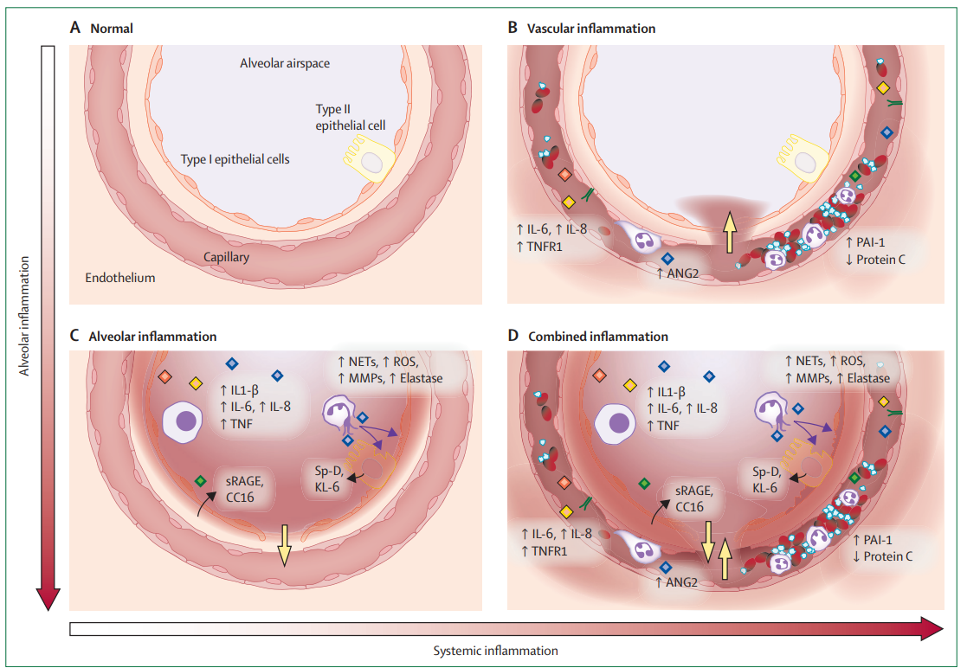
Phenotyping ARDS: Subphenotype
Systemic vs.
Alveolar inflammatory
Bos Lieuwe & Ware Lorraine Lancet 2022;400:1145

Slide 17
Phenotyping ARDS: Subphenotype (Radiological Findings)
Diffuse and patchy loss of aeration vs. focal :
Diffuse type: response well to alveolar recruitment strategies with improved gas exchange and lung mechanics
Focal type with predominant dorsal-inferior consolidation: response better to prone positioning
A 20% of patients are misclassified in the infrequent use of CT imaging study
A 10% decreased in mortality in a personalized ventilation strategy, but a substantial increase in mortality when exposed to a misaligned ventilation strategy.
Constantin JM Lancet RM 2019;7:870. Constantin JM Crit Care Med 2010;38:1108. Bos Lieuwe & Ware Lorraine Lancet 2022;400:1145

Slide 18
Guideline Recommendations for ARDS Management (1)
 | The Intensive Care Society and the Faculty of ICM (BTS) | The French Intensive Care Society | The ATS, European Society of ICM, and the society of CCM | WHO living guideline (COVID-19 ARDS)
Non-invasive ventilation | -- | -- | -- | Conditional recommendation in mild ARDS
Lung protective ventilation | Recommended | Recommended | Recommended | Recommended
Prone positioning | Recommended in mod-to-severe ARDS | Recommended in PaO2/FiO2 ratio <150mmHg | Recommended in severe ARDS | Recommended in PaO2/FiO2 ratio <150mmHg
High PEEP strategy | Recommended in mod-to-severe ARDS | Recommended in mod-to-severe ARDS | Recommended in mod-to-severe ARDS | Conditional recommended for mod-to-severe ARDS
Gorman EA, O’Kane CM & McAuley D Lancet 2022;400:1157

Slide 19
Guideline Recommendations for ARDS Management (2)
 | The Intensive Care Society and the Faculty of ICM (BTS) | The French Intensive Care Society | The ATS, European Society of ICM, and the society of CCM | WHO living guideline (COVID-19 ARDS)
Spontaneous ventilation | -- | No recommendation due to insufficient evidence | Research recommendation | --
Recruitment maneuvers | -- | Not recommended | Not routinely recommended | --
ECMO | Recommended in severe ARDS | Recommended when PaO2/FiO2 <80mmHg or lung protective ventilation is not possible | Research recommendation | Conditional recommendation for when PaO2/FiO2 ratio <80mmHg despite lung protective ventilation
Extracorporeal carbon dioxide removal | Research recommendation | Not recommendation due to insufficient evidence | Research recommendation | --
Conservative fluid strategy | Recommended | -- | -- | Recommended
HFOV = high-frequency oscillatory ventilation. ECMO = extracorporeal membrane oxygenation. Gorman EA, O’Kane CM & McAuley D Lancet 2022;400:1157

Slide 20
Guideline Recommendations for ARDS Management (3)
 | The Intensive Care Society and the Faculty of ICM (BTS) | The French Intensive Care Society | The ATS, European Society of ICM, and the society of CCM | WHO living guideline (COVID-19 ARDS)
Neuromuscular blockade | Recommended in early mod-to-severe ARDS | Recommended in early ARDS with a PaO2/FiO2 ratio of <150mmHg | -- | Not routinely recommended for all patients
Inhaled vasodilators | Not recommended | Can be use when hypoxemia persists despite lung protective ventilation and prone position, and before ECMO | -- | --
Corticosteroids | Research recommendation | -- | -- | Recommended
Other agents | -- | -- | -- | IL-6R blockers or JAK inhibitor is a strong recommendation
Gorman EA, O’Kane CM & McAuley D Lancet 2022;400:1157

Slide 21
Guideline Recommendations for ARDS Management (4)
Am J Respir Crit Care Med. 2024:24-36

Slide 22
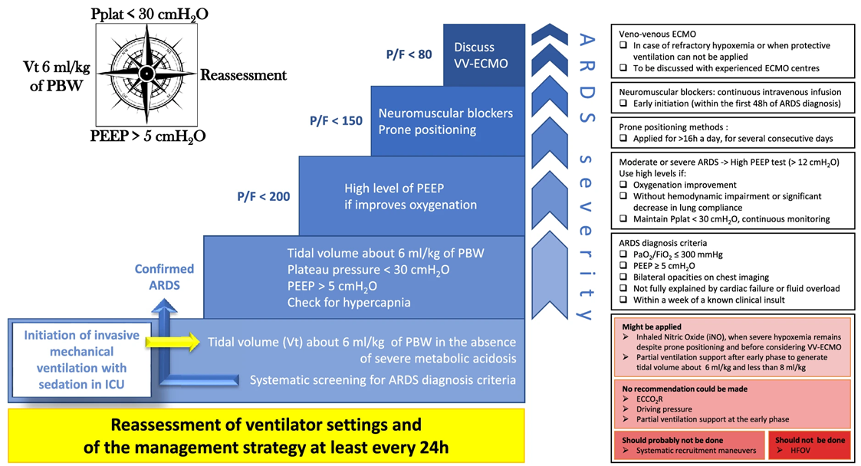
Guideline Recommendations for ARDS Management (5)
Ann Intensive Care 2019;9:69
Ann Intensive Care 2019;9:69

Slide 23
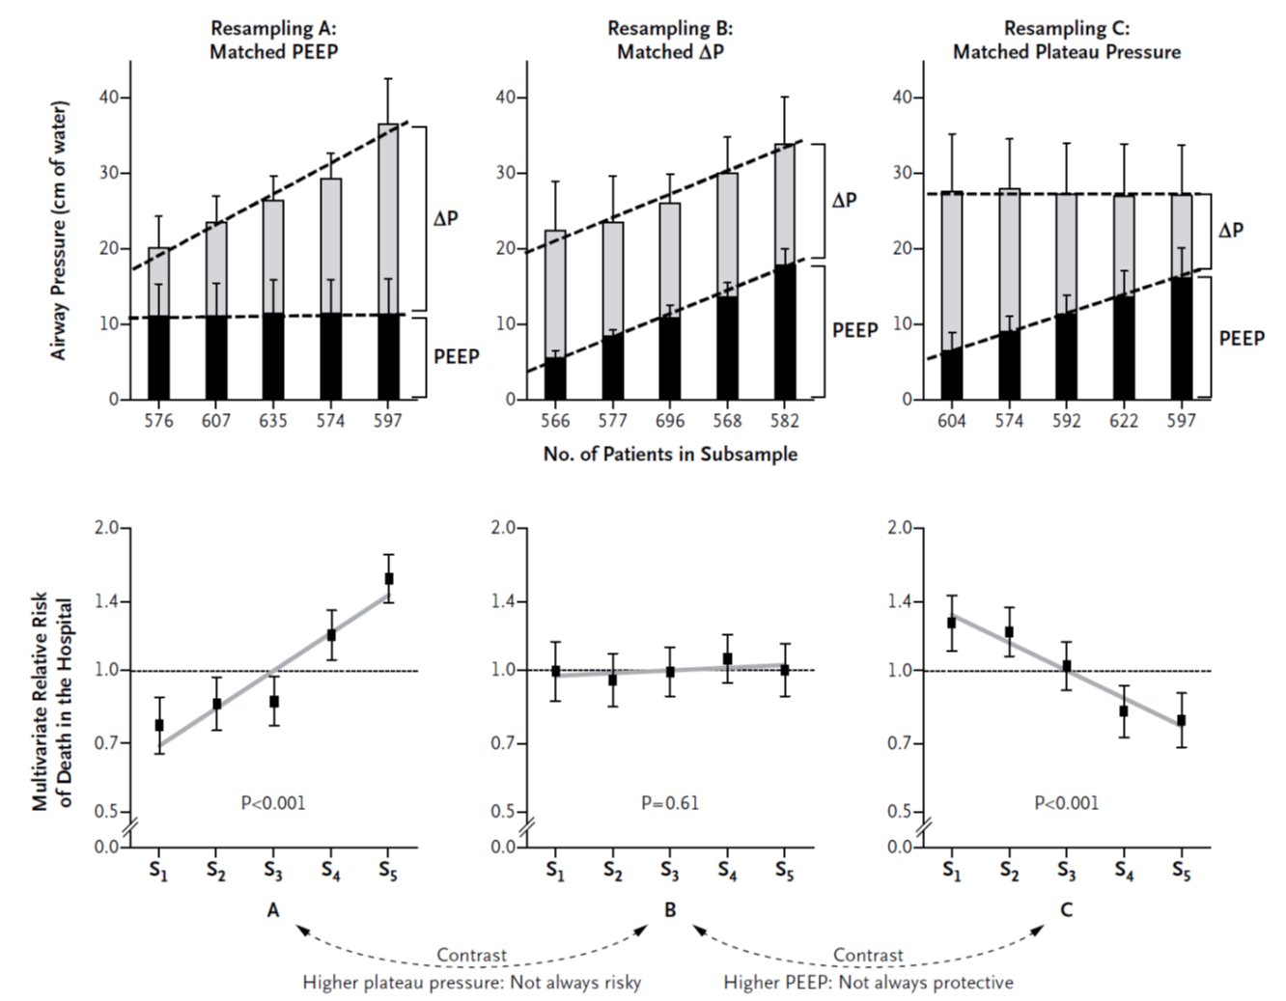
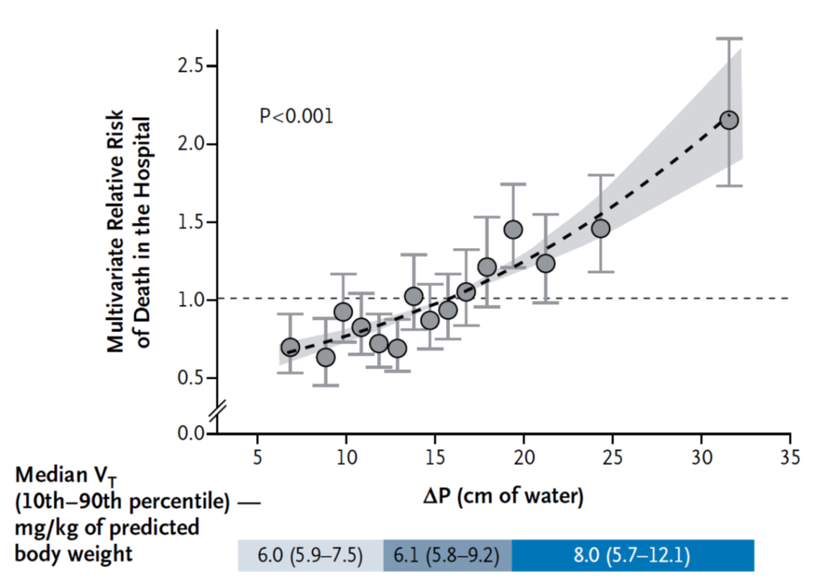
ARDS Management: Driving pressure
N Engl J Med 2015;19;372:747-55

Slide 24
ARDS Management: Driving pressure
Br J Anaesth. 2025 Mar;134(3):693-702.

Slide 25
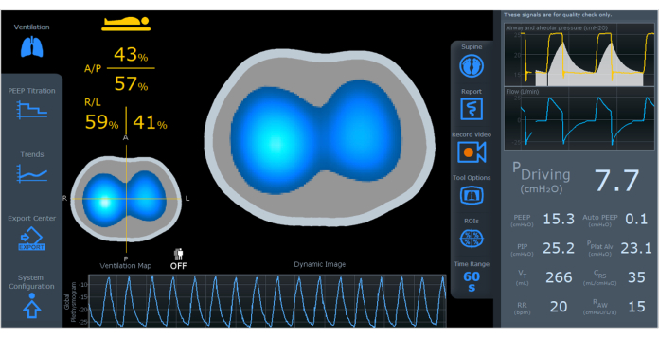
Electrical Impedance Tomography (EIT)
.
Guillaume Franchineau et al Am J Respir Crit Care Med 2024;209:670-682

Slide 26
PEEP Guided by EIT in ARDS
.
He et al Crit Care 2021:25;230. Peter Somhorst et al Crit Care 2022:26;272.

Slide 27
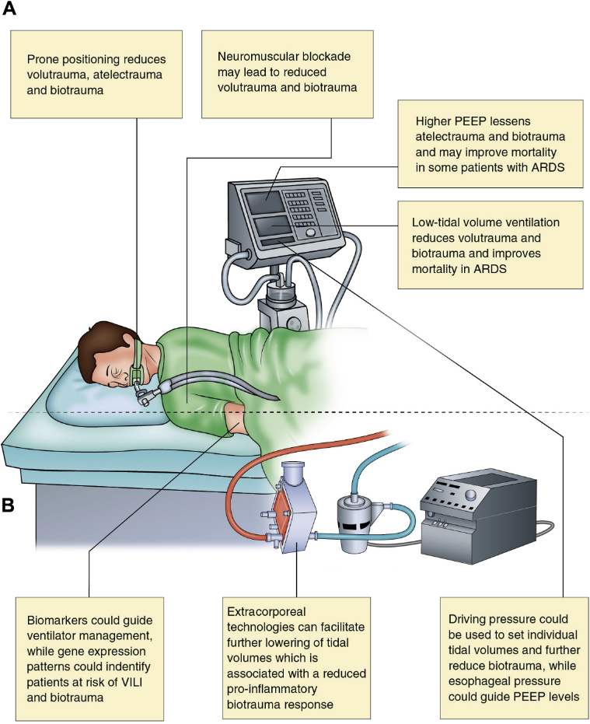

Mechanical Ventilation under ECMO use
Extracorporeal Life
Support Organization
Inspiratory plateau pressure (Pplat):
<25 cmH₂O
FiO₂: 30-50% (as low as possible)
PEEP: >10 cmH₂O
Respiratory rate: 4-15 breath/min
Tidal volume: 4-6 ml/kg
Joseph Tonna et al ASAIO J 2021;67:601-610. Gerard Curley et al Chest 2016;150:1109-1117

Slide 28
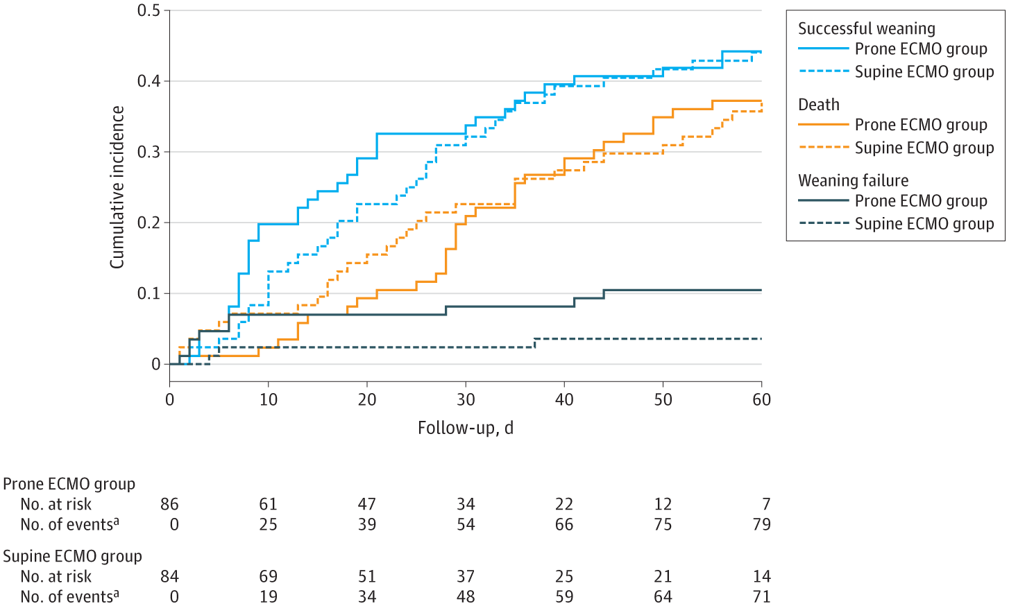
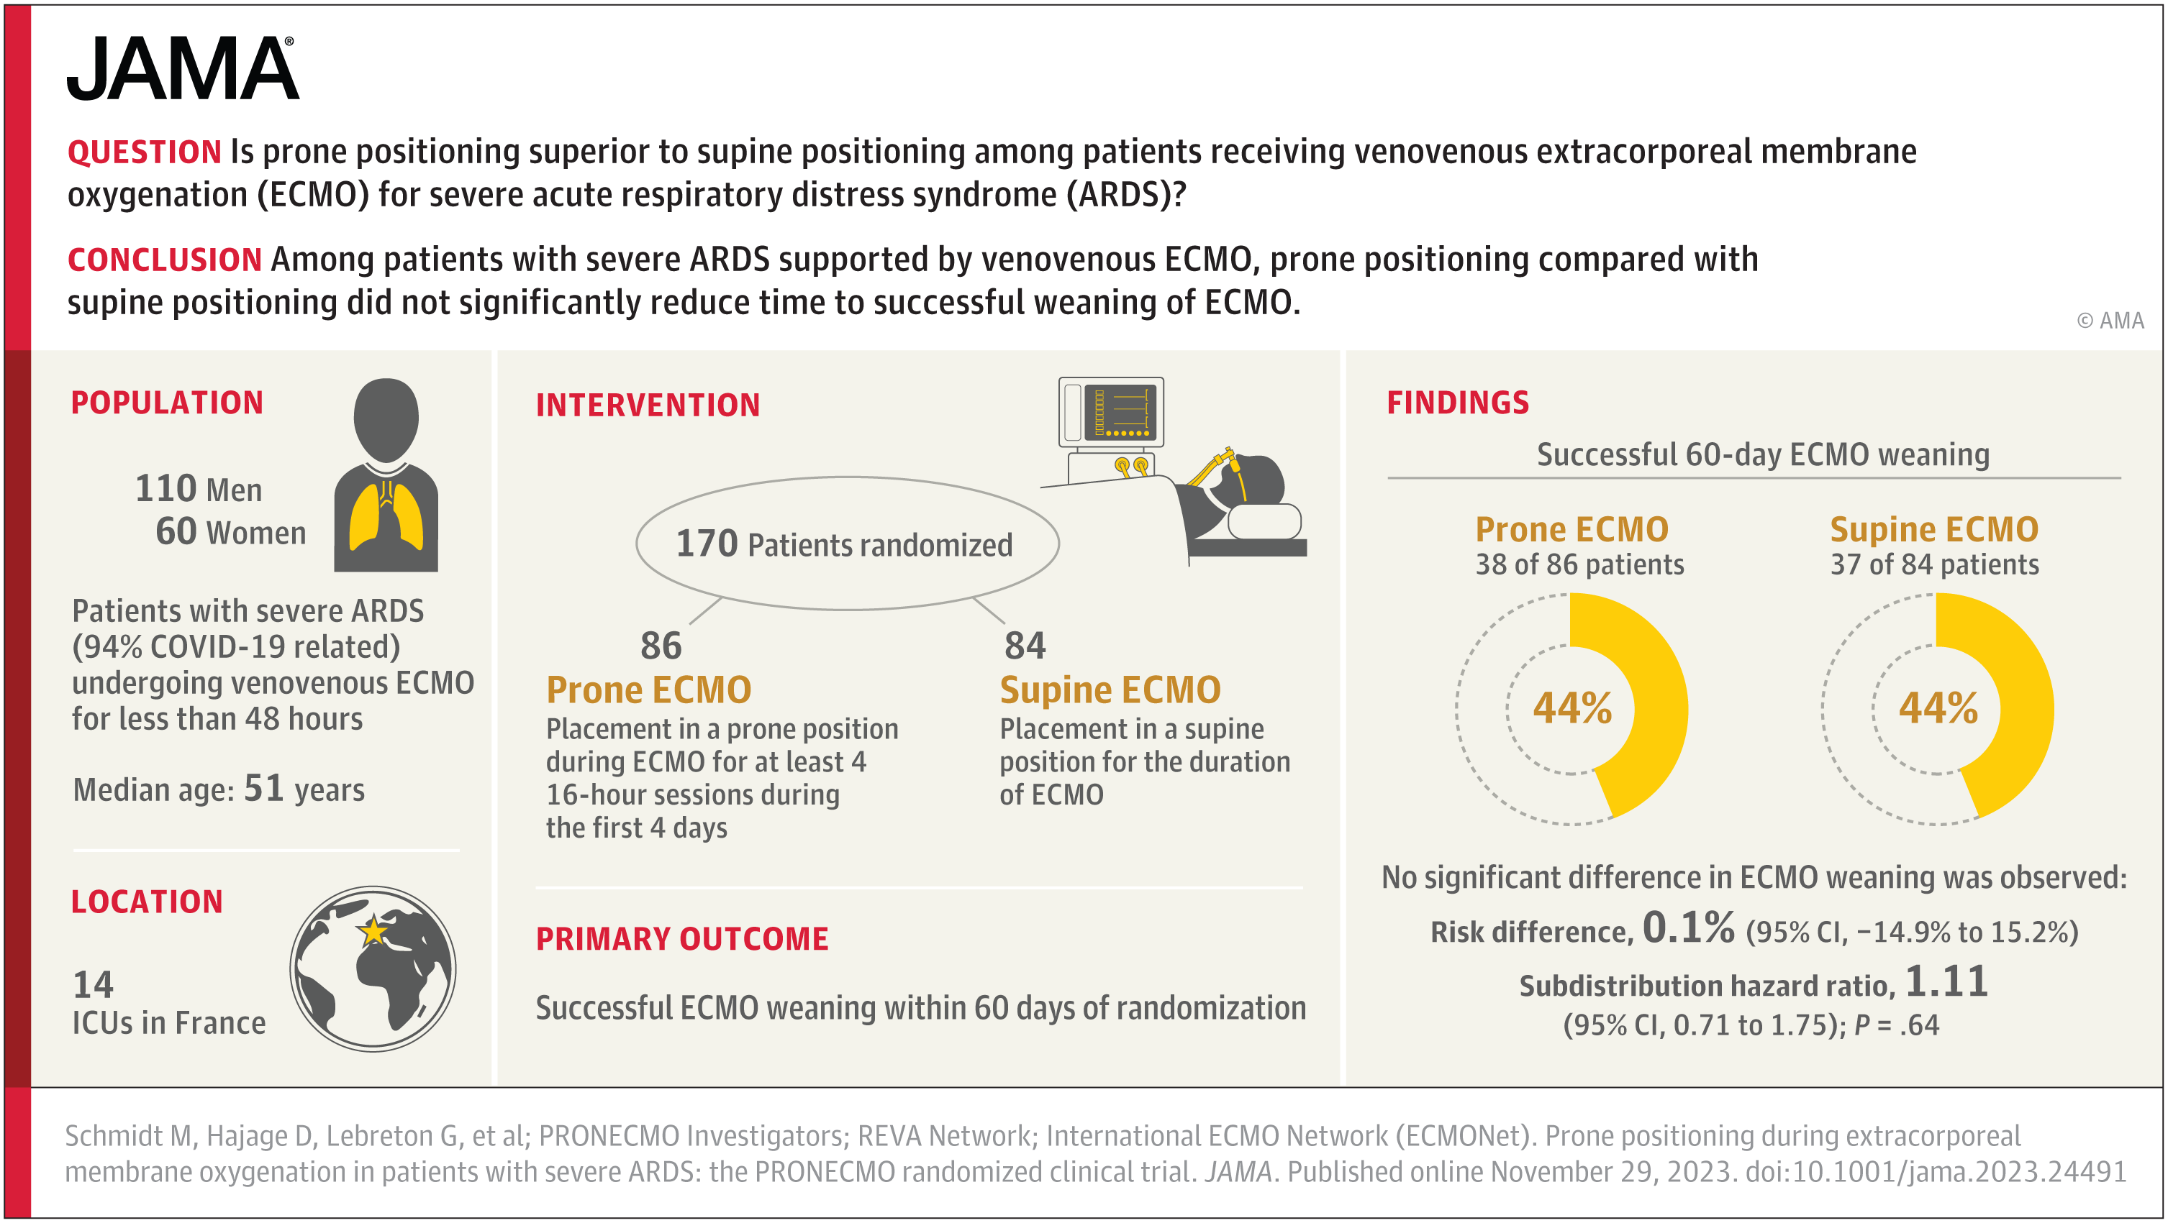
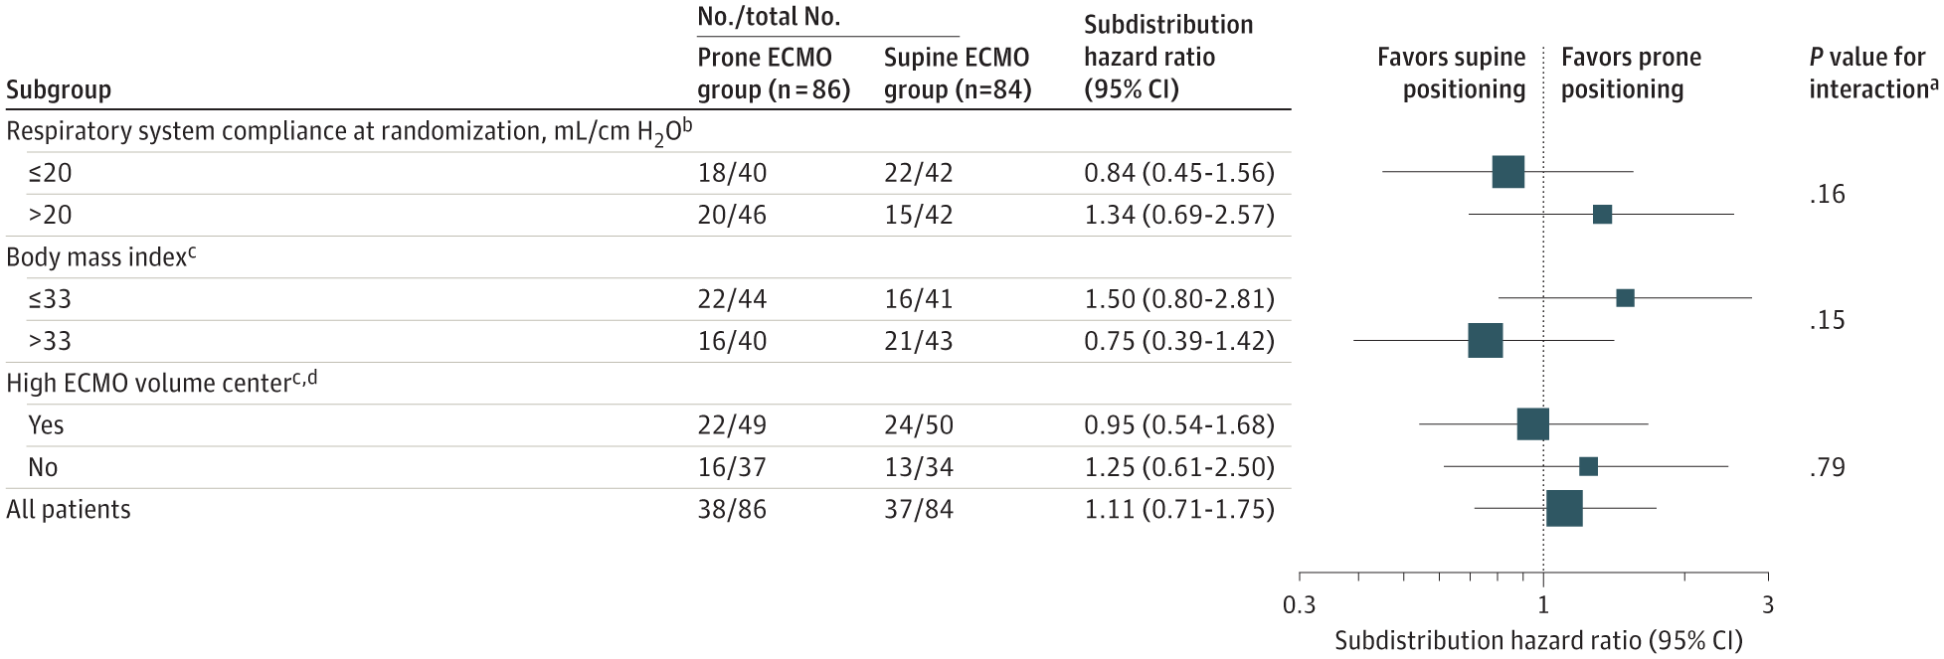
Prone Position under ECMO use
JAMA. 2023;330(24):2343-2353.

Slide 29

Precision Medicine for ARDS
Prognostic Enrichment and
Machine Learning
Predictive Enrichment
Heterogeneity

Slide 30
Conclusions
ARDS is a clinical syndrome of acute respiratory failure with the heterogeneity in clinical characteristics, biology, physiology and radiology.
The recognitions of phenotypes and endotypes (e.g. COVID-19 vs. non-COVID-19, hyper-vs. hypo-inflammatory, alveolar vs. vascular inflammation,……) provide the new insights for treatments/managements and may improve patient outcomes.
Protective lung strategies, prone positioning, high PEEP, ECMO, conservative fluid strategy, Neuromuscular blockade are recommended.
Additional treatments with anti-viral treatment, corticosteroid, anti-IL6R blockade, and JAK inhibitor are recommended in COVID-19 related ARDS according to WHO Covid-19 guideline .

